Slide 1
Image De-raining Using a Conditional Generative Adversarial Network
He Zhang, Member, IEEE, Vishwanath Sindagi, Student Member, IEEE Vishal M. Patel, Senior Member, IEEE
Notes:
第一页

Slide 2
Abstract
we enforcing an additional constraint that the de-rained image must be indistinguishable from its corresponding ground truth clean image.
we introduce a new refined loss function which aimed at reducing artifacts introduced by GANs and ensure better visual quality.
Generator sub-network is constructed by densely connected networks, discriminator is designed to leverage global and local information to decide if an image is real/fake.
Notes:
第二页

Slide 3
Introduction
A conditional GAN-based framework to address the challenging single image de-raining problem without the use of any additional post-processing.
A densely-connected generator sub-network that is specifically designed for the single image de-raining task.
A multi-scale discriminator is proposed to leverage both local and global information to determine whether the corresponding de-rained image is real or fake.

Slide 4
BACKGROUND
we discuss sparsity-based methods, low-rank method, gaussian mixture model methods and deep learning methods in solving image de-raining problem.

Slide 5
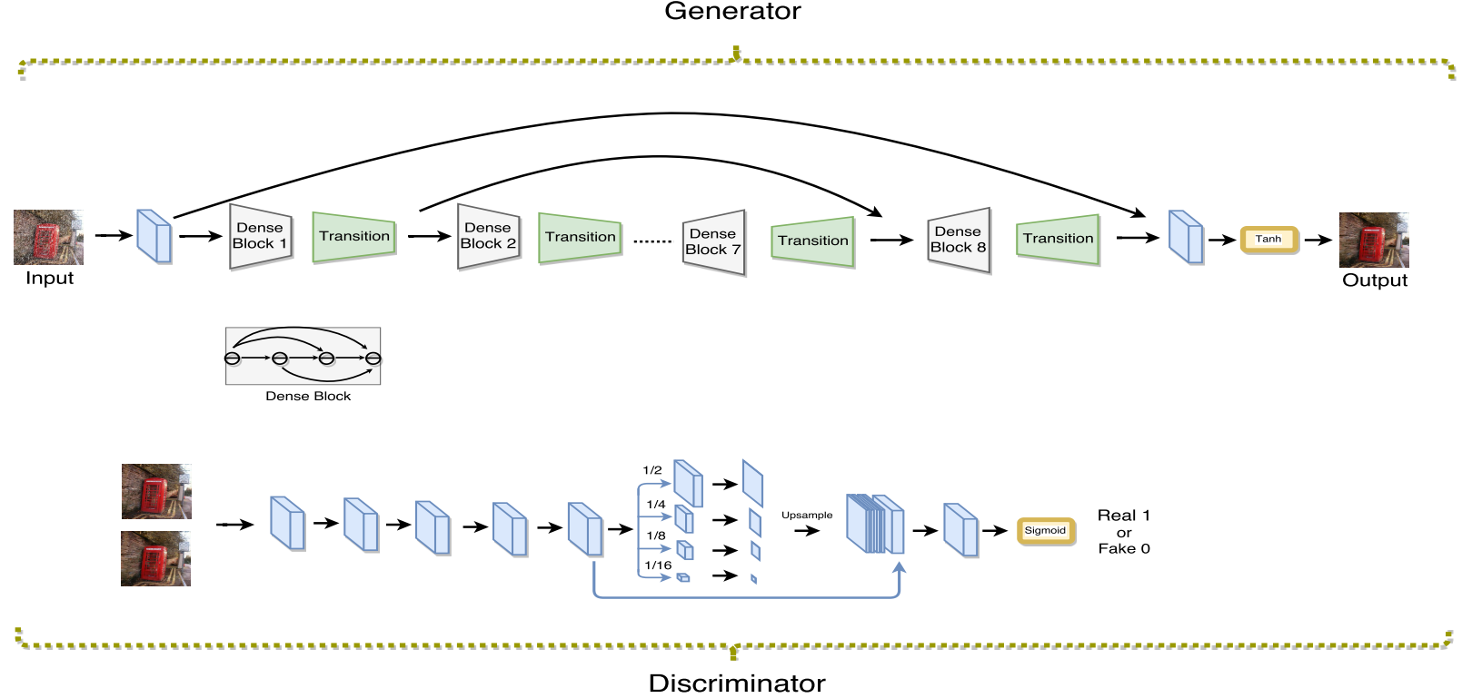
Proposed Method
ID-CGAN：generator, discriminator and perceptual loss function

Slide 6
A.GAN Objective Function
Given an input rainy image x, conditional GAN learns a non-linear function to synthesize the output image y by conditioning on the input image x.
B.Generator with symmetric structure
These dense blocks enable strong gradient flow and result in improved parameter efficiency.
we introduce skip connections across the dense blocks to efficiently leverage features from different levels and guarantee better convergence.
C. Multi-scale Discriminator
a multi-scale pooling module, which pools features at different scales, is stacked at the end of the discriminator.

Slide 7

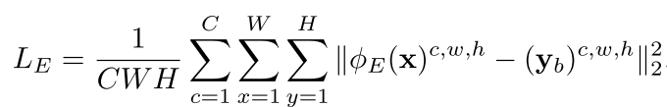
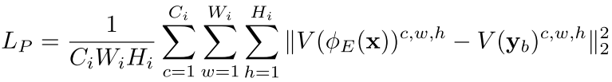
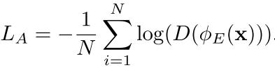
D. Refined Perceptual Loss
we combine pixel-to-pixel Euclidean loss, adversarial loss and perceptual loss together with appropriate weights to form our new refined loss function.

Slide 8
C.data
One picture with 14 different kinds，350 X 14 = 4900.
D.Combining CNN with image enhancement
Use non-linear function to enhance the base layer

